Slide 1
JavaScript Fundamentals
Lesson 11.1

Slide 2

The Big Picture
Python Unit
Python
Pandas
Matplotlib
APIs
Unit Assessment
Final Project
Project Design
Train Model & Build Database
Dashboards Presentation
Python Unit
Python
Pandas
Matplotlib
APIs
Unit Assessment
Visualization Unit
Web Scraping
Plotly
Leaflet
Tableau
Unit Assessment
Visualization Unit
Web Scraping
Plotly
Leaflet
Tableau
Unit Assessment
01
03
03
05
02
06
02
04
04
Excel Unit
Excel
VBA
Unit Assessment
Databases Unit
SQL
ETL
SQLite
Unit Assessment
Databases Unit
SQL
ETL
SQLite
Unit Assessment
Advanced Topics Unit
R—Stats
Big Data—AWS
Machine Learning
Unit Assessment
Notes:
Data

Slide 3
Consider teaming up with some of your classmates for virtual study groups as we get into this content!

Slide 4
This Week: JavaScript Fundamentals
Module 11

Slide 5
This Week: JavaScript Fundamentals
By the end of this week, you’ll know how to:
Explain the strengths and weaknesses of JavaScript "standard" and JavaScript version ES6+
Describe JavaScript syntax and ideal use cases
Build and deploy JavaScript functions, including built-in functions
Convert JavaScript functions to arrow functions
Build and deploy forEach (JavaScript for loop)
Create, populate, and dynamically filter a table using JavaScript and HTML

Slide 6
Using the skills learned throughout the week, create new search parameters and new JavaScript functions for UFO data to create an updated and dynamic webpage.

Slide 7

Career Connection
How will you use this module’s content in your career?

Slide 8
How to Succeed This Week
Module 11

Slide 9
Don’t forget to lean on documentation whenever you get stuck on syntax. You’ll be making robust visualizations in no time!

Slide 10
Today’s Agenda
Module 11

Slide 11
Today’s Agenda
By completing today’s activities, you’ll learn the following skills:
01
JavaScript variables and objects
02
JavaScript functions and arrow functions
03
Repetition and conditional statements
Make sure you’ve downloaded any relevant class files!

Slide 12
How comfortable do you feel with this topic?

Slide 13
Introduction to JavaScript

Slide 14
JavaScript
JavaScript fundamentals:
Arrays
Conditionals
Loops
Functions
Objects
Notes:
Explain that JavaScript shares many similarities with Python, but that there are also a number of differences, from typical usage to syntax.

Slide 15
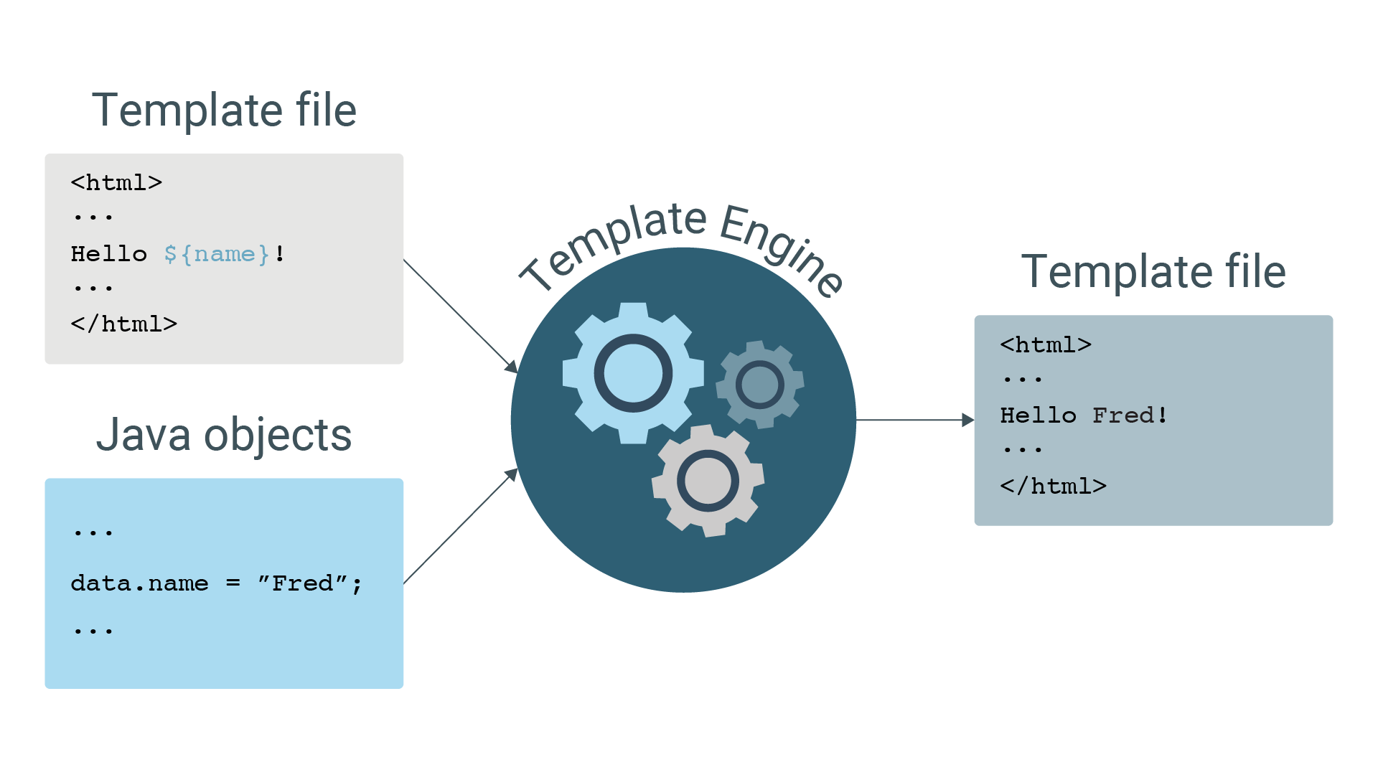
JavaScript
Just as important as the ability to crunch numbers is the ability to convey information to a wider audience, and JavaScript is the language of the web.
Template file
Template file
JavaScript objects
JavaScript objects

Slide 16
JavaScript makes it possible to create interactive web pages and visualizations.

Slide 17

JavaScript
Talk to us if you need extra help!
Notes:
Don't stay stuck, ask for help!
shutterstock_360676460

Slide 18
JavaScript shares many similarities with Python, but there are also a number of differences, including typical usage and syntax.

Slide 19
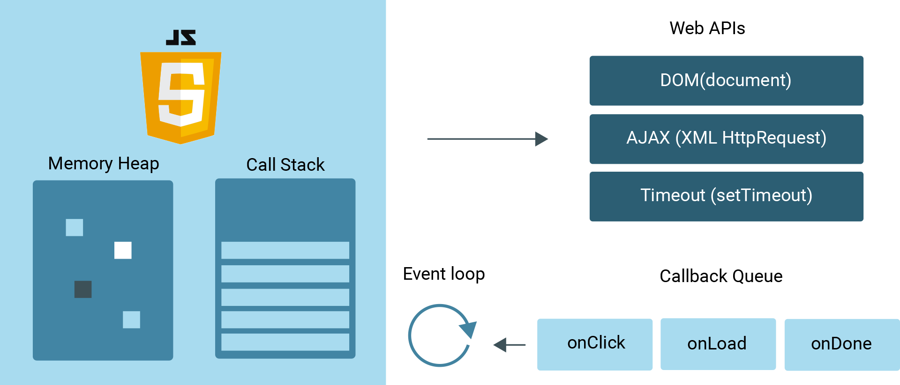
JavaScript
JavaScript is often used to place API calls to cloud data and services.

Slide 20
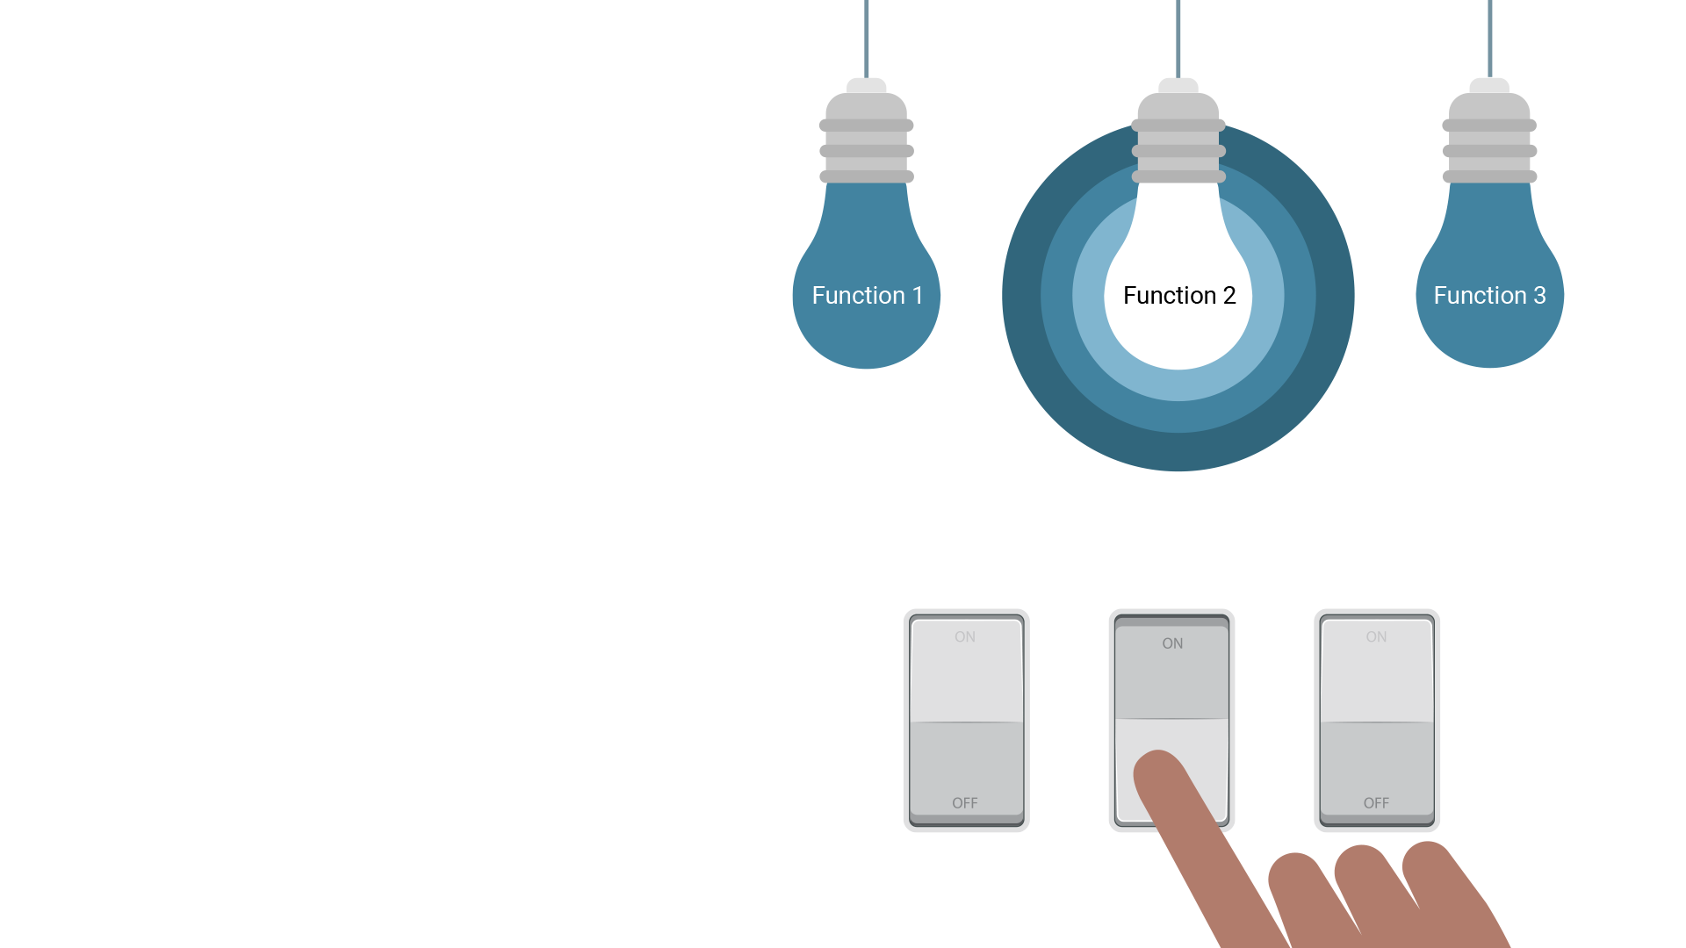
JavaScript
JavaScript also enables websites to send and receive data from a server, to respond to a user's actions on the page, and to dynamically modify HTML elements.

Slide 21
With JavaScript, it is possible to build interactive sites that do not require use of the command line interface

Slide 22
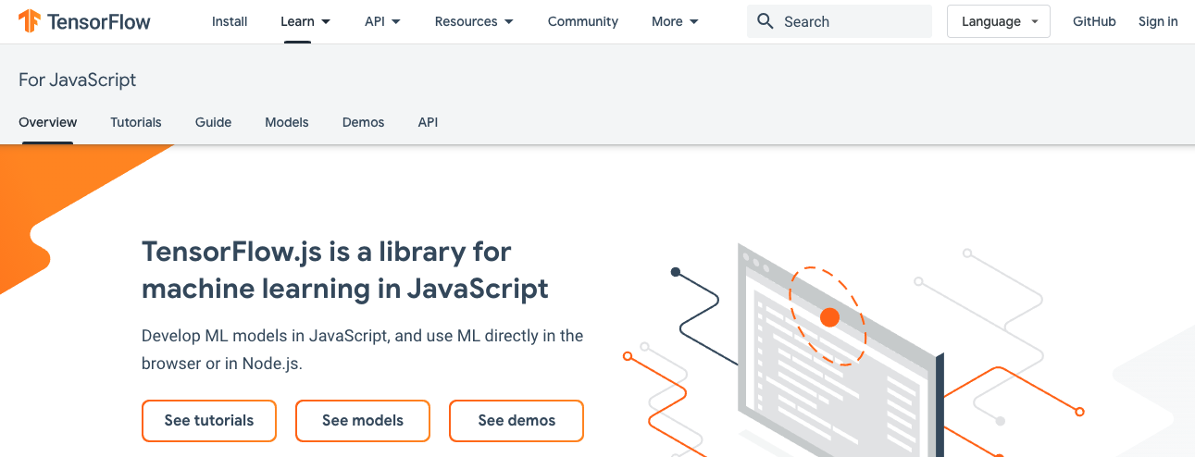
JavaScript
JavaScript is everywhere ... Even machine learning has been made available for the web browser
tensorflow.org

Slide 23
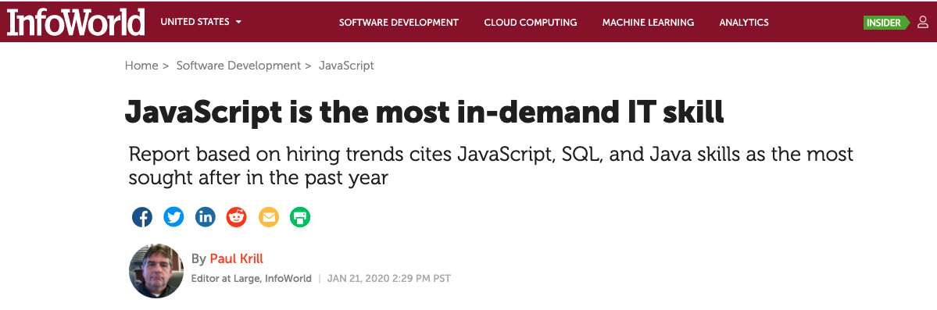
JavaScript
JavaScript is a very marketable and in-demand skill for any data position.
infoworld.com

Slide 24
How to Learn JavaScript

Slide 25


Your Brain on JavaScript
Notes:
First, learning JavaScript will take much longer than a single week.
shutterstock_184763024

Slide 26
JavaScript
General Tips:
Review Immediately | We’ll be building upon these concepts quickly. The firmer your grasp is now, the better off you’ll be.
Redo the Class Exercises | Don’t just reread! Actually spend the time to redo them from scratch on your own.
Get Help | Come to office hours. Ask conceptual questions. Ask specific questions. Just keep asking questions!
Don’t Be Afraid | You will get this. It will take time, but you will get this. Just keep at it. Patience will pay off.

Slide 27
Running JavaScript
Notes:
2.2 Instructor Do: Running JavaScript

Slide 28
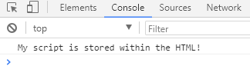
Running JavaScript
JavaScript is the language of the web, so its code is commonly found in HTML.
<!DOCTYPE html>
<html lang="en">
<head>
<title></title>
<meta charset="UTF-8">
<meta name="viewport" content="width=device-width, initial-scale=1">
</head>
<body>
<h1>Open the Chrome Inspector Console!</h1>
<script type="text/javascript">
console.log("My script is stored within the HTML!")
</script>
</body>
</html>
The code is placed between a pair of script tags.
The console.log() function prints out a message to a web browser’s built-in console.
Notes:
Since JavaScript is the language of the web, its code is commonly associated with HTML documents, or inside HTML documents.
Open up 01-Ins_JavaScript/Solved/script-within.html with a text editor and go over the code with the class.
The JavaScript code is placed between a pair of script tags inside of the HTML file. This means the code will run when the webpage has loaded.
The console.log() function allows the developer to print out a message to a web browser's built-in console. This message can be viewed by opening up the inspector and navigating into the console tab.

Slide 29
Running JavaScript
src="app.js"
<!DOCTYPE html>
<html lang="en">
<head>
<title></title>
<meta charset="UTF-8">
<meta name="viewport" content="width=device-width, initial-scale=1">
</head>
<body>
<h1>Open the Chrome Inspector Console!</h1>
<!-- src contains the path to the file -->
<script src="app.js"></script>
</body>
</html>
app.js
// This code will run when linked to in HTML
console.log("My script is stored outside of the HTML!")
Notes:
Now open up 01-Ins_JavaScript/Solved/script-outside.html with a text editor and go over this code with the class.
The opening script tag in this HTML application includes a src attribute that refers to an external JavaScript file.
The HTML file links to an external JavaScript file named app.js, but it does not contain JavaScript code itself.
If app.js were inside a directory called static, the src would contain the appropriate path to that file: <script src="static/app.js">.
Next, open Activities/01-Ins_JavaScript/Solved/app.js, whose code is simply: console.log("My script is stored outside of the HTML!");
The code inside this external file will run as if it were included within the HTML itself. The console message from the developer will be printed as soon as the webpage loads.

Slide 30
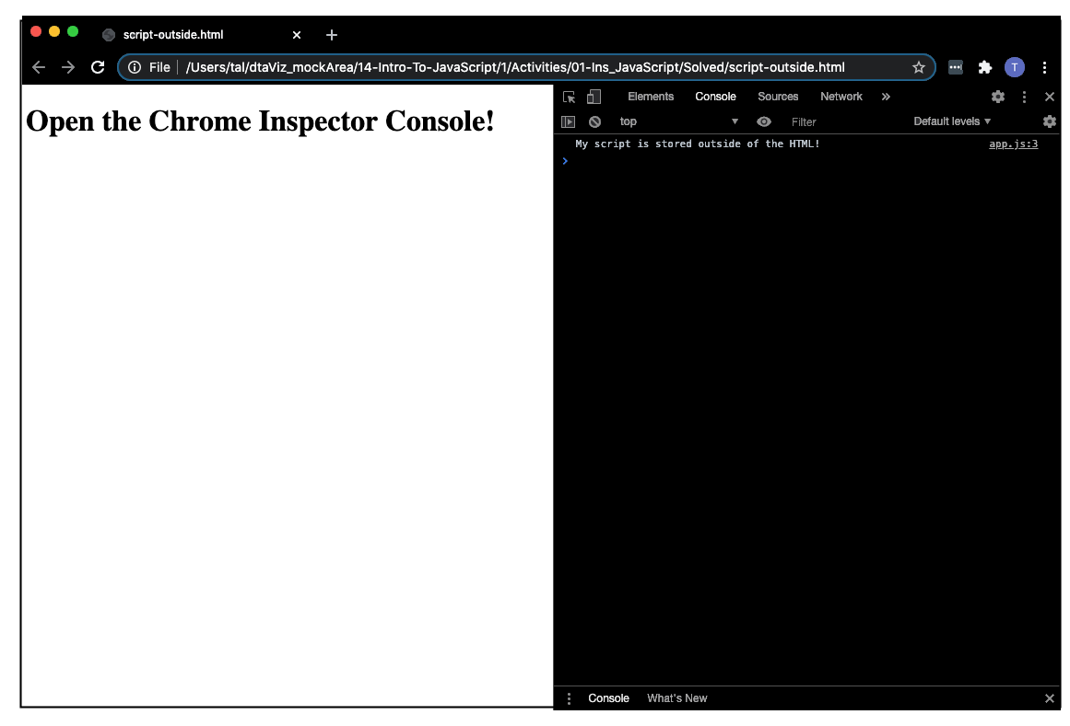
Running JavaScript
Notes:
Load up 01-Ins_JavaScript/Solved/script-outside.html within the browser and open the inspector's console to show the class the message that is printed.
Let the class know that using external JavaScript files is far more common than writing JavaScript into the HTML itself since this allows developers to easily reuse code.
When the same code is used on multiple sites or HTML pages, it makes sense to have the JavaScript code separated into its own js file.
If necessary, reiterate that linking an external JavaScript file inside the HTML file is essentially the same as copying and pasting the code inside the <script> tags.
Emphasize that when more than one external script file is referenced inside the HTML document, the order matters!
For example, if a variable that is declared in one JavaScript file is used inside another, the file in which it is declared must be referenced first in the HTML document.
Answer whatever questions students may have before moving onto the next activity.

Slide 31
From Python to JavaScript

Slide 32


From Python to JavaScript
Python and JavaScript are logically and syntactically similar.
Notes:
1.3
Files:
1-HelloVariableWorld
python_hello_variable_world.py
hello-variable-world.js
hello-variable-world.html
2-Conditional Check
python_conditional_check.py
conditional-check.js
conditional-check.html
For this activity, the class will work their way through some of the introductory Python scripts and translate them into JavaScript code. Make certain to point out the similarities/differences between these two programming languages while going over the code.
Before opening up anything, explain that JavaScript and Python are logically and syntactically similar, so many of the skills learned from Python will translate into JavaScript.
Explain that the following code examples will be sent out to use as a reference for future activities.
When coding these activities, open up the original Python script next to the JavaScript code. This way students can easily compare and contrast the two languages.

Slide 33
Variables
<variable Name> = <Value>
var <variable Name> = <Value>;
name = "Mad Max"
var name = "Mad Max";

Slide 34
Booleans
<variable Name> = True
var <variable Name> = true;
satisfied = True
var satisfied = true;

Slide 35
String template + Note:
# Python f-string
// JavaScript template literal
print(f"Hello, {name}!")
console.log(`Hello ${name}!`);

Slide 36
String Format Converted into Numeric Format
# int() function
// parseInt() function
weekly_wage = hourly_wage * int(weekly_hours)
var weeklyWage = hourlyWage * parseInt(weeklyHours);

Slide 37
From Python to JavaScript
15 minutes
Notes:
2.3 Everyone Do: From Python to JavaScript (0:15)
In this activity, everyone will work their way through some of the introductory Python scripts and translate them into JavaScript code.

Slide 38
Conditionals with Comparison Operators (== vs ===)
# Use whitespace with indentation
// Use curly brackets
if x == 1:
print("x is equal to 1")
if (x === 1) {
console.log("x is equal to 1");
}

Slide 39
Conditional with Logical Operators: and
# and
// &&
if x == 1 and y == 10:
print("Both values returned true")
if (x === 1 && y === 10) {
console.log("Both values returned true");
}

Slide 40
Conditional with Logical Operators: or
# or
// ||
if x < 45 or y < 5:
print("One or the other statements were true")
if (x < 45 || y < 5) {
console.log("One or the other statements were true");
}

Slide 41
Nested Conditionals
# if...elif...else
// if...else if...else
if x < 10:
if y < 5:
print("x is less than 10 and y is less than 5")
elif y == 5:
print("x is less than 10 and y is equal to 5")
else:
print("x is less than 10 and y is greater than 5")
if (y < 5) {
console.log("x is less than 10 and y is less than 5");
}
else if (y === 5) {
console.log("x is less than 10 and y is equal to 5");
}
else {
console.log("x is less than 10 and y is greater than 5");
}

Slide 43
Variables, Arrays, and Objects
Notes:
3.1 Instructor Do: Variables, Arrays, and Objects

Slide 44
JavaScript Arrays
15 minutes
Notes:
3.2 Everyone Do: JavaScript Arrays (0:15)

Slide 45
JavaScript arrays are similar to Python lists.

Slide 46
JavaScript Arrays
JavaScript array
index
var lettersArray = ["a", “b” , “c”, “d”];
var firstLetter = lettersArray[0];
var secondLetter = lettersArray[1];
a
b

Slide 47
JavaScript Arrays
.push()
.slice()
lettersArray.push("e");
var letterArray = ["a", “b” , “c”, “d”, “e”];
var slicedArray1 = lettersArray.slice(1);
// Return the first three items of an array
var slicedArray2 = lettersArray.slice(0, 3);
// Return the second and third items of an array
var sliced Array 3 = lettersArray.slice(1, 3);

Slide 48
JavaScript Arrays
.join()
.split()
var joinedArray = lettersArray.join(", ");
var soundArray = soundOfMusic.split(" ");

Slide 50
for Loops
Notes:
4.1 Instructor Do: for Loops (0:05)

Slide 51
for Loops in JavaScript
Start
End condition
Increment
for (var i = 0; i < 10; i++) {
console.log("Iteration #", i);
}

Slide 52
for Loops on an Array in JavaScript
var students = ["Johnny", "Bodhi", "Pappas"];
for (var j = 0; j < students.lengths; j++) {
console.log(students[j]);
}
Start
End condition
Increment

Slide 53
Activity: Movie Scores
In this activity, you will use conditionals and loops to iterate through an array of movie scores and sort scores into new arrays by their values.
15 minutes
Notes:
4.2 Students Do: Movie Scores (0:15)

Slide 54
Instructions: Movie Scores
Given a list of movie scores, determine how many good, ok, and bad movies there were.
Create a for loop to go through the movieScore list.
Add scores over 7 to the goodMovies array.
Add scores between 5 and 7 to the okMovies array.
Add the rest of the scores to the the badMovies array.
Also, calculate the average rating for all of the movies.
Finally, print out how many good, ok, and bad movies there were, and what the overall total score was.
Hints:
You will need to research how to push elements to an empty array.
Check your Slack for the documentation to find the length of the array.
Notes:
4.2 Students Do: Movie Scores (0:15)
In this activity, students will use `for` loops and conditional statements with comparison operators to determine how many good, okay, and bad movies there are in the movie score array. They will also determine the average movie score rating.

Slide 55
Notes:
4.3 Review: Movie Scores (0:05)

Slide 56
JavaScript Functions
Notes:
NOTE: PLEASE SKIP SHOWCASING CHROME INSPECTOR OUTPUT UNTIL THE END OF SLIDE 50.
Compare and contrast Python functions to JavaScript functions!

Slide 57
Functions
def
function
def print_hello():
print("Hello there!")
function printHello()
console.log("Hello there!");
}
Notes:
In Python, functions are declared with the def keyword, while JavaScript used function.
Python functions declaration are then finished by adding a colon with indented code written underneath.

Slide 58
Functions
def
function
print_hello()
addition(44, 50):
printHello();
console.log(addition(44, 50));
Notes:
Functions must be called to execute the code.

Slide 59
Functions
# Takes in a list and loops through
// Accepts a parameter and iterates through an array
def list_loop(user_list):
for i in user_list:
print(i)
function listLoop(userList) {
for (var i = 0; i < userList.length; i++) {
console.log(userList[i]);
}
}
var friends = ["Sarah", "Greg", "Cindy", "Jeff"];
listLoop(friends);

Slide 60
Functions
# Uses previously declared function
// Functions can call other functions
def double_addition(c, d):
total = addition(c, d) * 2
return total
function doubleAddition(c, d) {
var total = addition(c, d) * 2;
return total;
}
// Log results of doubleAddition function
console.log(doubleAddition(3, 4));

Slide 61
Functions
# Python built in function for rounding
// JavaScript built in functions
long_decimal = 112.34534454
rounded_decimal = round(long_decimal)
print(rounded_decimal)
var longDecimal = 112.34534454;
var rounded Decimal = Math.floor(longDecimal);
console.log(rounded Decimal);

Slide 62
Activity: Statistics Functions
In this activity, you will create functions that return statistical values from any given array of data.
15 minutes
Notes:
5.2 Students Do: Statistics Functions (0:15)

Slide 63
Instructions: Movie Score Statistics
01
Using the movie array from earlier as a starting point, create functions that will return statistical values from any given array of data.
Create functions that will find the following:
Mean
Variance
Standard Deviation
Each function should console.log both the name of the statistic used and its value. For example: "The Mean is: 33.3".
The functions should be able to take any array of numbers and return the statistical value.
After you have the functions working with movie data set, run them on the following additional data points: monthlyAvgRainFall = [3.03, 2.48, 3.23, 3.15, 4.13, 3.23] mileRunTimes = [5.06, 4.54, 5.56, 4.40, 7.10]
Hints:
Use the JavaScript Math library to handle calculations needing exponents or square roots.
Check your Slack to refresh on how to calculate variance and standard deviation.
02
03
04
Notes:
Activities/08-Stu_Stats_Functions/README.md
Activities/08-Stu_Stats_Functions/Unsolved/static/js/app.js
Activities/08-Stu_Stats_Functions/Unsolved/index.html
NOTE: SLACK: variance and standard deviation.

Slide 64
Notes:
5.3 Review Statistics Functions (0:05)

